Slide 1
Introduction To Programming
Loops, Conditionals, Bitwise operations

Slide 2
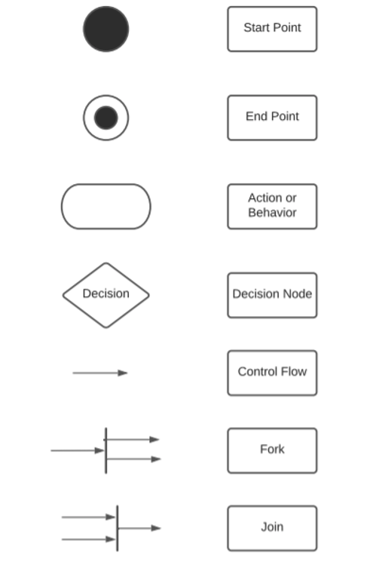
UML
Universal Markup Language – a tool used to model activities, relationships, logic trees etc.
Very commonly used in programming to make concise and understandable diagrams.
The basic syntax is fairly straightforward.

Slide 3
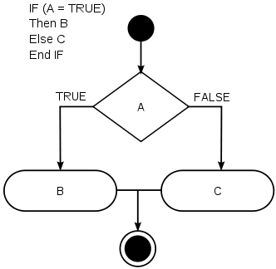
Control Statements – if
The if statement is used to execute code logic, based on the result of the returned truth value of the expression.
Logical and relational operators can be used within the expression to express the test. (See Lesson 3 slides 12 and 13 for available logical operators)
Basic Usage: if (expression) then-statement else if (expression2) then-statement 2 else else-statement

Slide 4
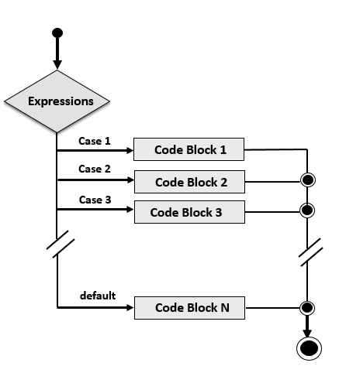
Control Statements - switch
The switch statement can be used to handle multiple results of an expression). It is used to avoid long chains of if-else if blocks.
The default case
switch (expression) { case compare-1: if-equal-statement-1 case compare-2: if-equal-statement-2 … default: default-statement }

Slide 5
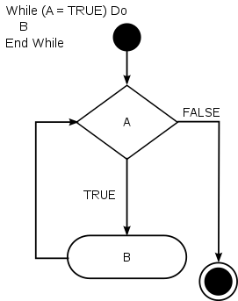
Loops - while
The while statement is a loop statement with an exit expression at the beginning of the loop. while (expression) statement

Slide 6
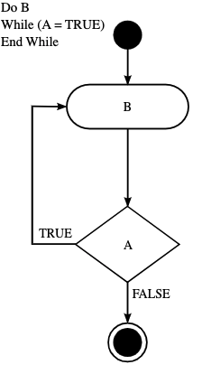
Loops - do
The do statement is a loop statement with an exit expression at the end of the loop. do statement while (expression);

Slide 7
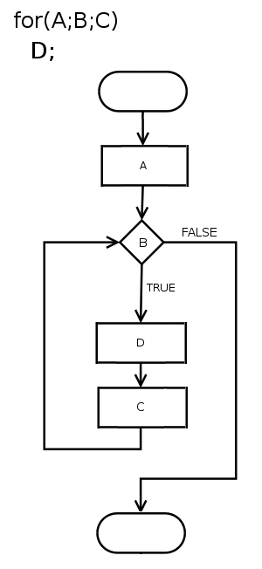
Loops - for
“The for statement is a loop statement whose structure allows easy variable initialization, expression testing, and variable modification” - GNU C reference. [1] The for statement consists of a starting value, an ending value and an increment – is useful in cases, when we want the computer to do something X number of times. for (initialize; test; step) statement

Slide 8
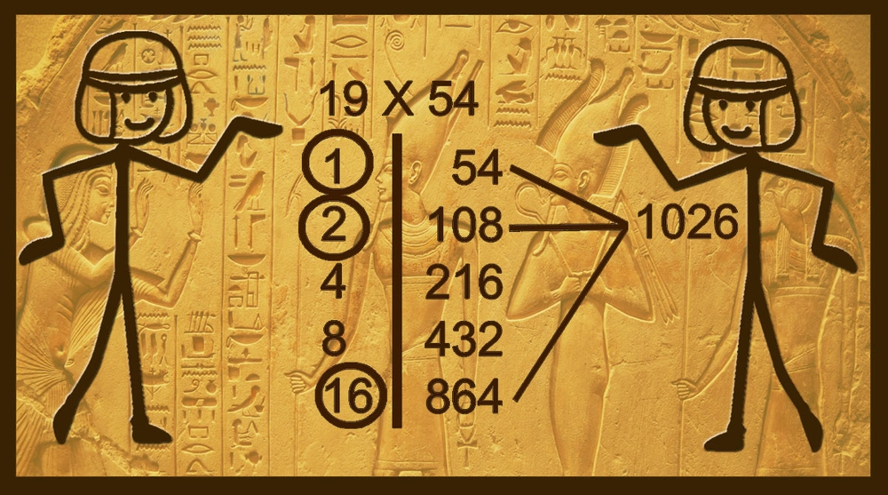
Example algorithm: Egyptian multiplication

Slide 9
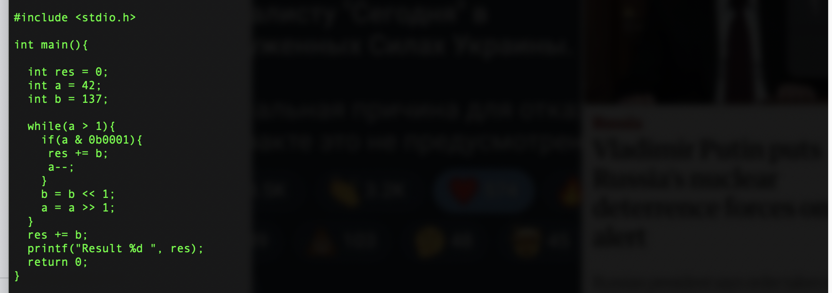
C implementation example

Slide 10
Bitwise operation
The & (bitwise AND) in C takes two numbers as operands and does AND on every bit of two numbers. The result of AND is 1 only if both bits are 1.
The | (bitwise OR) in C takes two numbers as operands and does OR on every bit of two numbers. The result of OR is 1 if any of the two bits is 1.
The ^ (bitwise XOR) in C takes two numbers as operands and does XOR on every bit of two numbers. The result of XOR is 1 if the two bits are different.
The << (left shift) in C takes two numbers, left shifts the bits of the first operand, the second operand decides the number of places to shift.
The >> (right shift) in C takes two numbers, right shifts the bits of the first operand, the second operand decides the number of places to shift.
The ~ (bitwise NOT) in C takes one number and inverts all bits of it

Slide 11
Exercise 1
Solid snake has tasked you with writing a password protection system for the mainframes. The user should have 3 tries to enter the password “WarshipIdiNahui”. If the user fails 3 times, exit the program with an error code, If the user succeeds, greet them!

Slide 12
Exercise 2
Mario’s menu - Now that Mario’s pizza place is up and running, serving only one kind of pizza in different sizes, he has started thinking entrepreneurally, and decided to expand his menu to feature the following flavours: a) Frutti di mare b) Pepperoni c) Quattro Stagione d) Four cheeses e) Chicken-pineapple Help him by creating a digital menu for his customers, which presents the options and confirms the order back.

Slide 13
Exercise 3
Jon Snow is having trouble remembering his watchtower schedule, and since it was given to him as a bitmasked array, he desperately needs your help to make sense of it. Help him by creating a program that allows Jon to enter the week number he is interested in, and returns the days on duty based on that. (optional) Also, allow Jon to update the schedule.
Jon’s schedule: https://pastebin.com/UPnKWqVC

